Slide 1
UNIT-1
Fundamental of Cryptography

Slide 2
Outline
Chapter:1 Introduction
  Security Goal/Objectives
  OSI Security Architecture
  Security Attacks
  Security Services
  Security Mechanism
  A model for Network Security
Notes:
X.800 and RFC 2828
International Telecommunication Union (ITU)

Slide 3
Unit : 1
(Chapter : 1)
Introduction

Slide 4
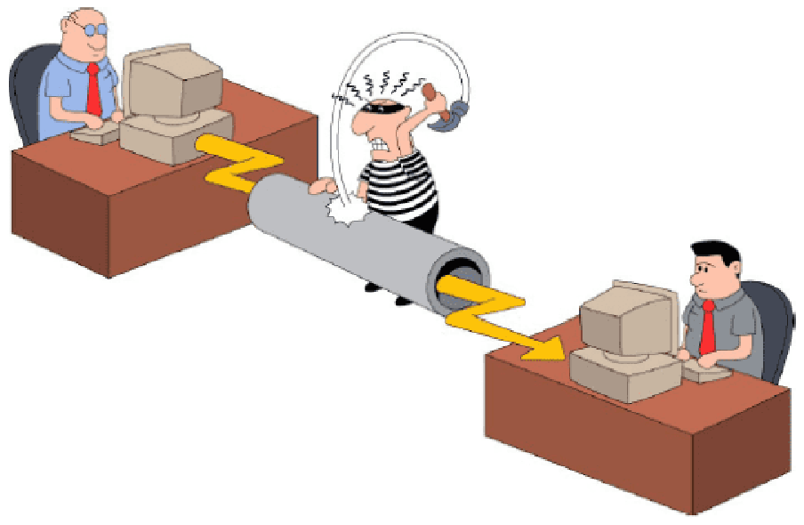
Introduction to Information & N/W Security

Slide 5
Information & Network Security
What is Information ?
  The processed form of data or meaningful data is called information. Basically, information is the message that is being conveyed.
What is Security ?
  Computer Security : Generic name for the collection of tools designed to protect data.
  Network and Internet Security : Measures to protect data during their transmission over a collection of interconnected networks.
Data
Process
Information

Slide 6

Key Security Objectives
Goal/Objectives of Security :
  Confidentiality
  Integrity
  Availability
  Authenticity
  Accountability

Slide 7




Confidentiality
Confidentiality:
  Data confidentiality: Assure confidential information not made available to unauthorized individuals.
  Example : Individual files are locked and secured
Bob
Alice
Packet sniffing, illegal copying
Attacker

Slide 8
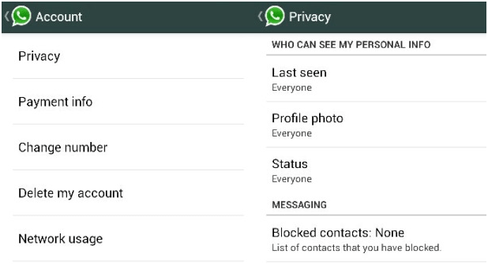
Confidentiality
  Privacy: Assure individuals can control what information related to them is collected, stored, distributed.
  Privacy is the right of an individual to protect personal or sensitive information.

Slide 9
Integrity
Integrity :
  Data integrity: Assure information and programs are changed only in a authorized manner.
Message
Bob
Alice
Modifies the message, or Inserts a new one.
Message
How can Bob be sure that message really comes from Alice?
Attacker

Slide 10
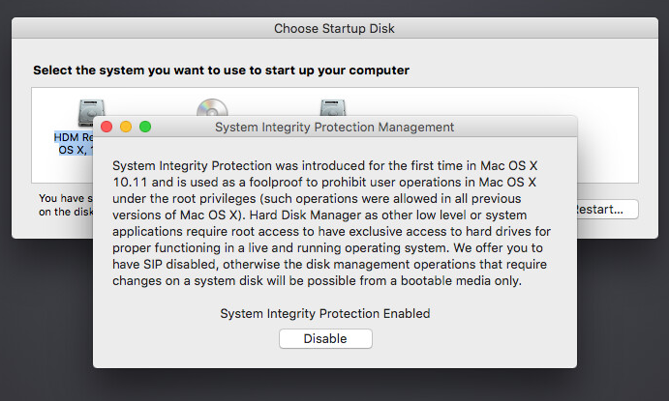
Integrity
    System integrity: Assure system performs intended function.

Slide 11




Availability
Availability :
  Assure that systems work promptly and service is not denied to authorized users.
www.amazon.com
User
Browser working
Server down

Slide 12



Authenticity
Authenticity:
  The property of being genuine and being able to be verified and trusted; confidence in the validity of a transmission, a message, or message originator.
  This means verifying that each input arriving at the system came from a trusted source.
Password
+
Verification
=
Access

Slide 13


Authenticity
Transfer Rs. 1,00,000
From A to C.
I am User A
User A
Bank
User C

Slide 14
Accountability
Accountability:
  The security goal that generates the requirement for actions of an entity to be traced uniquely to that entity.
  This supports nonrepudiation(assurance that someone cannot deny something).
Transfer Rs. 1,00,000
to Bank
User A
Bank

Slide 15
Impact of Security Breaches
Effectiveness of primary operations are reduced
  Example: Hackers compromised exam question paper.
Financial loss
  Example: The cost of repairing a company database once it’s been compromised.
Damage to assets
  Example: Hackers compromised Amazon Web Services account and demanded a ransom. When the company declined, the hacker started destroying their resources.
Harm to individuals
  Example: Hackers compromised patience database and change it.

Slide 16
OSI Security Architecture
Systematic approach to define requirements for security and approaches to satisfying those requirements
The OSI (Open Systems Interconnection) security architecture focuses on Security Attacks, Mechanisms, and Services.
Security Attack: Any action that compromises the security of information owned by an organization.
Security Mechanism: A process that is designed to detect, prevent, or recover from a security attack.
Security Service: A communication service that enhances the security of the data processing systems and the information transfers of an organization.

Slide 17
Security Attacks

Slide 18
Security Attacks
A passive attack attempts to learn or make use of information from the system but does not affect system resources.
  Release of message contents
  Traffic analysis
Relatively hard to detect, but easier to prevent
An active attack attempts to alter system resources or affect their operation.
  Masquerade
  Replay
  Modification of messages
  Denial of service.
Relatively hard to prevent, but easier to detect

Slide 19
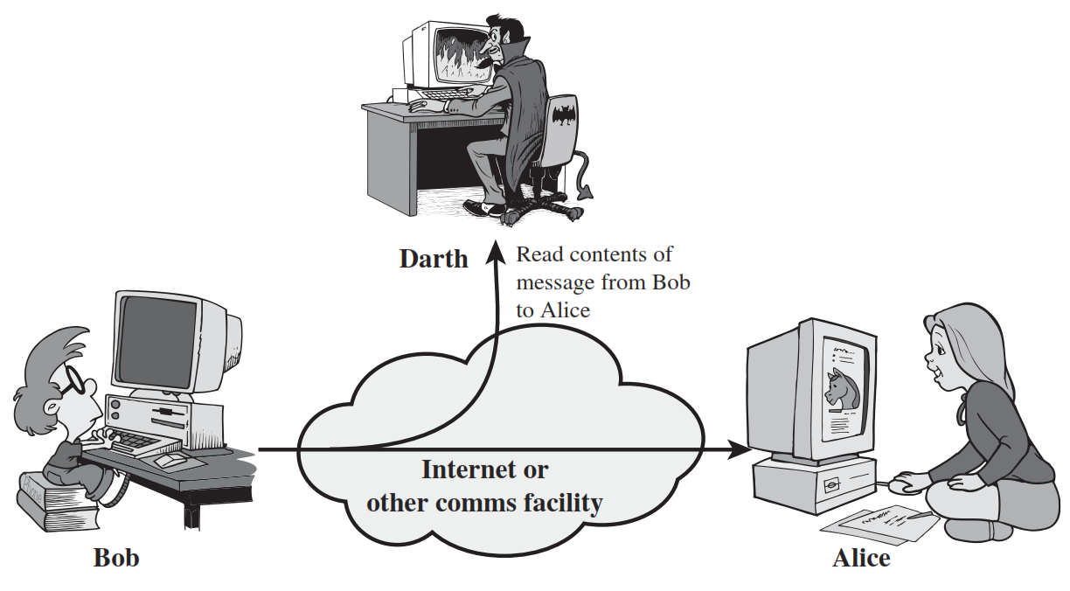
Release of message contents (Passive Attack)
A telephone conversation, an electronic mail message, and a transferred file may contain sensitive or confidential information.
We would like to prevent an opponent from learning the contents of these transmissions.
Attack on Confidentiality.

Slide 20
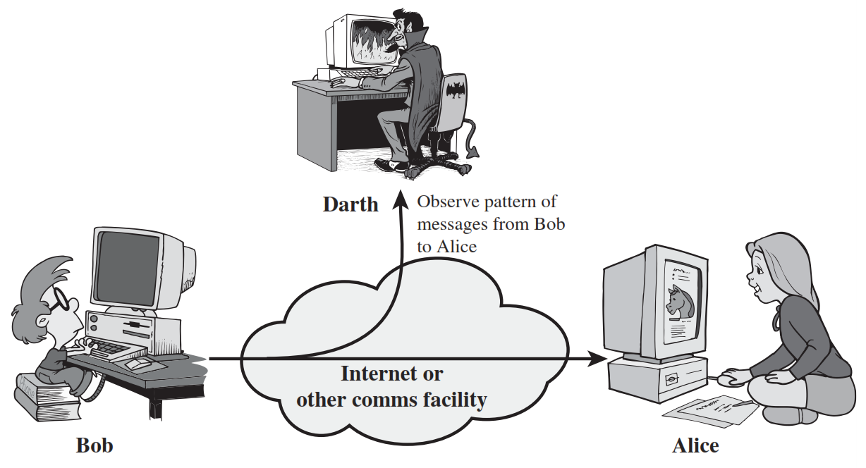
Traffic Analysis (Passive Attack)
In such attacks, an attacker analyses the traffic and observes the frequency and length of exchanged messages. He uses all this information to predict the nature of communication.
Studying the flow of "traffic" to find patterns of behaviour.

Slide 21
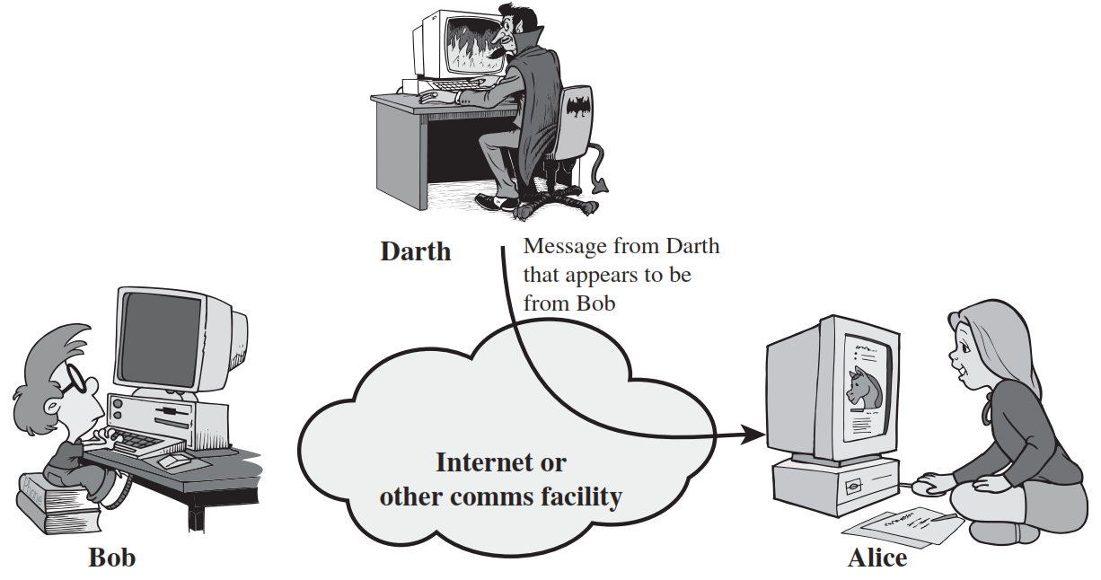
Masquerade Attack (Active Attack)
A masquerade takes place when one entity pretends to be a different entity.
A masquerade attack is an attack that uses a fake identity to gain unauthorized access to personal information.
Attack on Authentication.

Slide 22

Replay Attack (Active Attack)
Replay attack involves the passive capture of a data unit and its subsequent retransmission to produce an unauthorized effect.
Replay attack is to replay the message sent to a network by an attacker, which was earlier sent by an authorized user.

Slide 23
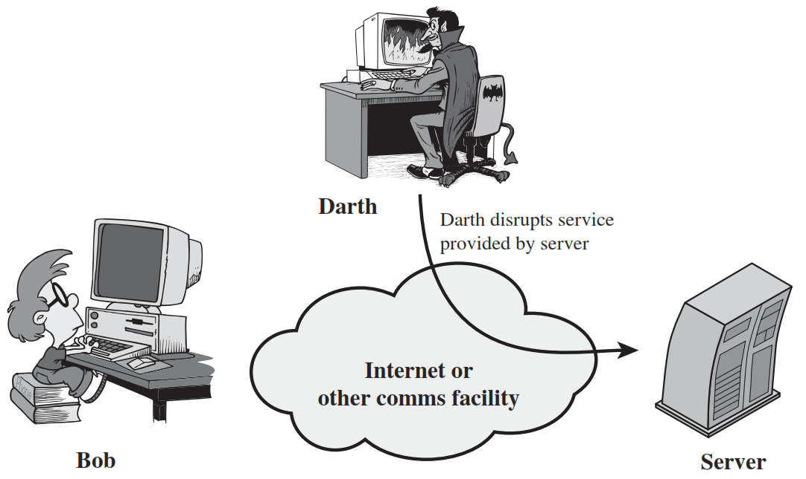
Modification of messages Attack (Active Attack)
Modification of messages simply means that some portion of a legitimate message is altered, or that messages are delayed or reordered, to produce an unauthorized effect.
Attack on Integrity.

Slide 24
Denial of Service Attack (Active Attack)
The denial of service attack prevents the normal use or management of communications facilities.
Sending large number of packets to block the server.
Attack on Availability.

Slide 25
Security Services

Slide 26
Security Services (X.800)
X.800 standard defines a security service as a service that is provided by a protocol layer of communicating open systems and that ensures security of the systems or of data transfers.
X.800 divides these services into five categories and fourteen
specific services.
Notes:
a processing or communication service that is provided by

Slide 27
Security Services
Authentication
Access Control
Data Confidentiality
Data Integrity
Non Repudiation
Peer Entity Authentication
Connection Confidentiality
Connection Integrity with recovery
Non Repudiation Origin
Data Origin Authentication
Connection less Confidentiality
Connection Integrity with out recovery
Non Repudiation Destination
Selective Repeat Confidentiality
Selective Field Connection Integrity
Traffic Flow Confidentiality
Connection less Integrity
Selective Field Connection less Integrity

Slide 28

Authentication
Authentication is the assurance that the communicating entity is the one that it claims to be.
Peer Entity Authentication: Used in association with a logical connection (TCP) to provide confidence in the identity of the entities connected.
Data-Origin Authentication: In a connectionless (UDP) transfer, provides assurance that the source of received data is as claimed.
Who you are ? (biometrics)
Physical authentication
where you are ?
What you know ?
Password
One-time Password(OTP)
Notes:
Peer Entity Authentication: Used in association with a logical connection to provide confidence in the identity of the entities connected.
Data-Origin Authentication: In a connectionless transfer, provides assurance that the source of received data is as claimed.

Slide 29
Security Services
Authentication
Access Control
Data Confidentiality
Data Integrity
Non Repudiation
Peer Entity Authentication
Connection Confidentiality
Connection Integrity with recovery
Non Repudiation Origin
Data Origin Authentication
Connection less Confidentiality
Connection Integrity with out recovery
Non Repudiation Destination
Selective Repeat Confidentiality
Selective Field Connection Integrity
Traffic Flow Confidentiality
Connection less Integrity
Selective Field Connection less Integrity

Slide 30

Access Control
Access control is the prevention of unauthorized use of a resource
This service controls who can have access to a resource, under what conditions access can occur, and what those accessing the resource are allowed to do.
User A
User B
Human resources
network
Development
network

Slide 31
Security Services
Authentication
Access Control
Data Confidentiality
Data Integrity
Non Repudiation
Peer Entity Authentication
Connection Confidentiality
Connection Integrity with recovery
Non Repudiation Origin
Data Origin Authentication
Connection less Confidentiality
Connection Integrity with out recovery
Non Repudiation Destination
Selective Repeat Confidentiality
Selective Field Connection Integrity
Traffic Flow Confidentiality
Connection less Integrity
Selective Field Connection less Integrity

Slide 32
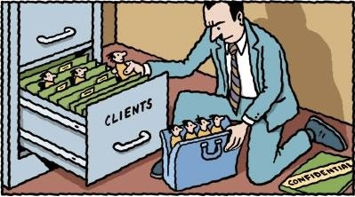
Data Confidentiality
Data confidentiality is the protection of data from unauthorized disclosure.
Connection Confidentiality: The protection of all user data on a connection.
Connectionless Confidentiality: The protection of all user data in a single data block.
Selective-Field Confidentiality: The confidentiality of selected fields within the user data on a connection or in a single data block.
Traffic-Flow Confidentiality: The protection of the information that might be derived from observation of traffic flows.

Slide 33
Security Services
Authentication
Access Control
Data Confidentiality
Data Integrity
Non Repudiation
Peer Entity Authentication
Connection Confidentiality
Connection Integrity with recovery
Non Repudiation Origin
Data Origin Authentication
Connection less Confidentiality
Connection Integrity with out recovery
Non Repudiation Destination
Selective Repeat Confidentiality
Selective Field Connection Integrity
Traffic Flow Confidentiality
Connection less Integrity
Selective Field Connection less Integrity

Slide 34

Data Integrity
Data integrity is the assurance that data received are exactly as sent by an authorized entity (i.e., contain no modification, insertion, deletion, or replay).
Channel
Alice
Bob
Both are same

Slide 35
Data Integrity (Cont…)
Connection Integrity with Recovery: Provides integrity of all user data on a connection and detects any modification, insertion, deletion, or replay of any data with recovery attempted.
Connection Integrity without Recovery: As above, but provides only detection without recovery.
Selective-Field Connection Integrity: Provides integrity of selected fields within the user data and takes the form of determination of whether the selected fields have been modified, inserted, deleted, or replayed.

Slide 36
Data Integrity (Cont…)
Connectionless Integrity: Provides integrity of a single connectionless data block and may take the form of detection of data modification. Additionally, a limited form of replay detection may be provided.
Selective-Field Connectionless Integrity: Provides integrity of selected fields within a single connectionless data block; takes the form of determination of whether the selected fields have been modified.

Slide 37
Security Services
Authentication
Access Control
Data Confidentiality
Data Integrity
Non Repudiation
Peer Entity Authentication
Connection Confidentiality
Connection Integrity with recovery
Non Repudiation Origin
Data Origin Authentication
Connection less Confidentiality
Connection Integrity with out recovery
Non Repudiation Destination
Selective Repeat Confidentiality
Selective Field Connection Integrity
Traffic Flow Confidentiality
Connection less Integrity
Selective Field Connection less Integrity

Slide 38
Non Repudiation
Nonrepudiation is the assurance that someone cannot deny something.
Typically, nonrepudiation refers to the ability to ensure that a communication cannot deny the authenticity of their signature on a document or the sending of a message that they originated.
Transfer Rs. 1,00,000
to Bank
After few days
User A
I have never requested to transfer Rs. 1,00,000
to Bank
Bank
Notes:
Hash functions, Digital signatures

Slide 39
Non Repudiation (Cont…)
Nonrepudiation-Origin: Proof that the message was sent by the specified party.
Nonrepudiation-Destination: Proof that the message was received by the specified party.

Slide 40
Security Mechanisms

Slide 41
Security Mechanisms (X.800)
Techniques designed to prevent, detect or recover from attacks
No single mechanism can provide all services
Common in most mechanisms: cryptographic techniques
Specific security mechanisms: Integrated into the appropriate protocol layer in order to provide some of the OSI security services.
Pervasive security mechanisms: Not integrated to any particular OSI security service or protocol layer

Slide 42
Security Mechanism (Specific security)
Encipherment: Hiding or covering data using mathematical algorithms.
Digital Signature: The sender can electronically sign the data and the receiver can electronically verify the signature.
Access Control: A variety of mechanisms that enforce access rights to resources.
Data Integrity: A variety of mechanisms used to assure the integrity of a data unit or stream of data units.

Slide 43
Security Mechanism (Specific security)
Authentication Exchange: Two entities exchange some messages to prove their identity to each other.
Traffic Padding: The insertion of bits into gaps in a data stream to frustrate traffic analysis attempts.
Routing Control: Selecting and continuously changing routes between sender and receiver to prevent opponent(attacker) from eavesdropping.
Notarization: The use of a trusted third party to assure and control the communication.

Slide 44
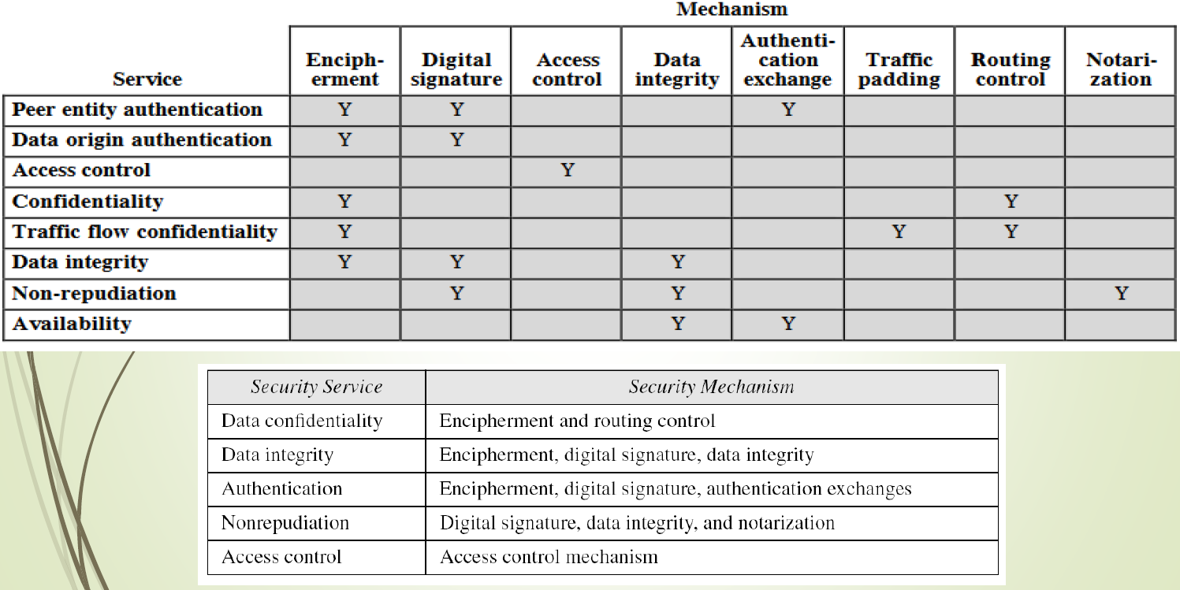
Relationship between Security Mechanism and Security Mechanism

Slide 45
Model for Network Security
Trusted third party
(e.g., arbiter, distributer
of secret information)
Sender
Recipient
Security -related Transformation
Info.
Channel
Security -related Transformation
Message
Secure
Message
Secure
Message
Message
Secret
Information
Secret
Information
Opponent
(Attacker)

